Slide 1

Bounded Buffer & Lock
Computer System Engineering, Fall 2018. (IPADS, SJTU)
Virtualizing the communication link
Yubin Xia

Slide 2

Virtualization: C/S on a Single Machine
in order to enforce modularity + build an effective operating system
programs shouldn’t be able to refer to
(and corrupt) each others’ memory
Virtual memory
programs should be able to
communicate
Bounded buffer (virtualize communication links)
programs should be able to share a
CPU without one program halting the
progress of the other
Assume one program per CPU (for today)

Slide 3
virtual link: bounded buffer

Slide 4
Virtual Communication Links
2^{n}
0
2^{n}
0
Module A
Module B
OS
Very similar with the C/S model

Slide 5
Enforce Modularity for Bounded Buffer
Adopt the same message-passing paradigm in C/S
To enable communication while keep isolation
Like RPC
Share a buffer in kernel
User mode cannot access the buffer directly
Applications use API to operate the buffer
Must transition to kernel mode to copy messages into/from the shared buffer

Slide 6
Bounded Buffer and its API
Bounded buffer: a buffer that stores (up to) N messages
Bounded buffer API
send (m)
m <- receive()

Slide 7
Enforce Modularity for Bounded Buffer
SEND() and RECEIVE()
Supervisor calls (e.g., system calls)
Copy the message from/to the thread’s domain to/from the shared buffer
Programs running in kernel mode is written carefully
Transitions between user mode and kernel mode can be expensive

Slide 8
Virtual Communication Links
Producer and Consumer Problem
Sender must wait when buffer is full
Receiver must wait when buffer is empty
Need sequence coordination

Slide 9
BB Implementation for single Sender

Slide 10
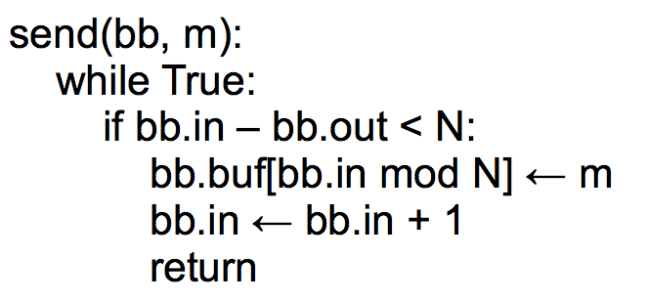
Bounded Buffer Send
Cannot switch the two
Notes:
Imagine that the buffer has zero elements in it. Program 1 has a
message to send. The if condition evaluates to True, and Program 1
increments bb.in. However, at the same time, Program 2 is trying to
read. Program 2's if-statement will also evaluate to true: right now,
bb.out = 0 and bb.in = 1. So Program 2 will try to read a message
from the buffer, but none has been written yet.

Slide 11
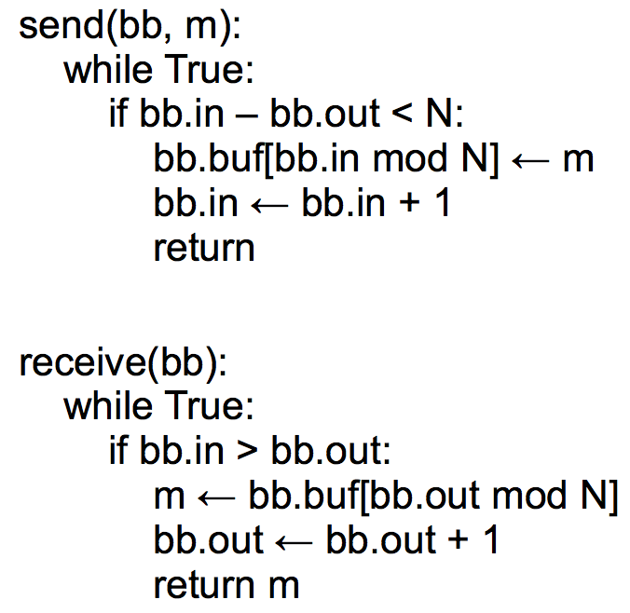
Bounded Buffer Send/Receive

Slide 12
Send/Receive Implementation Assumptions
Single producer & Single consumer
Each on own CPU
in and out do not overflow
read/write coherence (e.g., on cache)
in and out ensure before-or-after atomicity
The result of executing a statement becomes visible to other threads in program order
Compilers do not optimize the order
Notes:
2. if not, busy wait will just cost all CPU

Slide 13
Concurrency
This implementation works on two CPUs
One for a sender and one for a receiver
which is surprising!
Conventional wisdom tells us that if some resource is accessed by two (or more) CPUs at the same time, something might get wrong

Slide 14
Race Condition If Multi-Senders
Multiple Senders and Receivers

Slide 15
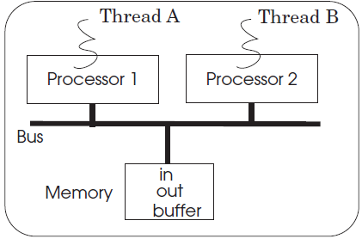
Multiple Senders
Multiple senders may send at the same time

Slide 16
Case 1
A
bb.in = 0, bb.out = 0
write m1 to buf[0]
set bb.in = 1
B
bb.in = 1, bb.out = 0
write m2 to buf[1]
set bb.in = 2
Everything works fine!

Slide 17
Case 2
A
bb.in = 0, bb.out = 0
write m1 to buf[0]
set bb.in = 1
B
bb.in = 0, bb.out = 0
write m2 to buf[0]
set bb.in = 1
m1 lost!

Slide 18
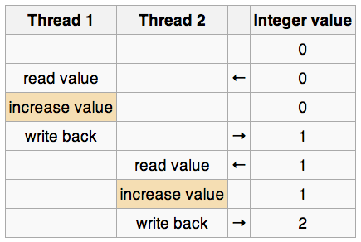
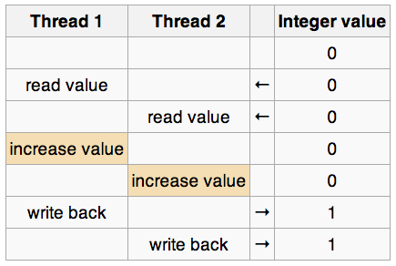
Race Condition
Race condition
Timing dependent error involving shared state
Whether it happens depends on how threads scheduled
Considering “i++” by 2 threads concurrently, with i =0:

Slide 19
Race Condition ─ Hard to Control
Must make sure all possible schedules are safe
Number of possible schedules permutations is huge
Bad schedules that will and will not work sometimes
They are intermittent
Small timing changes between invocations might result in different behavior which can hide bug (e.g., Therac-25)
Also known sa Heisenbugs (Heisenberg)
Solution-1: DMT (Deterministic Multi-Threading)
Solution-2: Record and Replay

Slide 20
Lock to the rescue (or not?...
Before-or-After

Slide 21
Locks: Before-or-after Atomicity
Widely used concept in systems
With a bunch of different names
Database community
Isolation and Isolated actions
Operating systems community
Mutual exclusion (mutex) and Critical sections
Computer architecture community
Atomicity and Atomic actions

Slide 22
Lock API
acquire(lock)
release(lock)
lock(lock)
unlock(lock)
OR
If a thread acquires a lock that is hold by another thread:
Case-1: Spin on current CPU with a loop (spinlock)
Case-2: Yield the current CPU (e.g., conditional variable)

Slide 23
Using Locks
Developer must figure out the possible race conditions and insert locks to prevent them
Puts a heavy load on the developer
Place acquire/release of locks in the code
Nothing is automatic
Forget one place, then you have race conditions
Forget to release a lock or try to acquire it twice, and you have likely have a deadlock
How to avoid that?

Slide 24
Send with Locking: Correct?
send(bb, message):
while True:
if bb.in – bb.out < N:
acquire(bb.send_lock)
bb.buf[bb.in mod N] <- message
bb.in <- bb.in + 1
release(bb.send_lock)
return
Notes:
Not correct. Concurrent senders will both think they can write.
One will get the lock and write, and then the other will get the lock,
but it might be that the first sender filled up the buffer (so that
the second shouldn't actually be writing).

Slide 25
Send with Locking: the Correct Version
send(bb, message):
acquire(bb.send_lock)
while True:
if bb.in – bb.out < N:
bb.buf[bb.in mod N] <- message
bb.in <- bb.in + 1
release(bb.send_lock)
return

Slide 26
Send with Locking: Another Version
send(bb, message):
while True:
acquire(bb.send_lock)
if bb.in – bb.out < N:
bb.buf[bb.in mod N] <- message
bb.in <- bb.in + 1
release(bb.send_lock)
return
release(bb.send_lock)

Slide 27
Implementing the Lock

Slide 28
Lock Implementation (Incorrect)
struct lock { integer state; };
void acquire (lock reference L) {
while L.state == LOCKED
; // spin until L is UNLOCKED
L.state = LOCKED; // the while test failed, got the lock
}
void release (lock reference L) {
L.state = UNLOCKED;
}

Slide 29
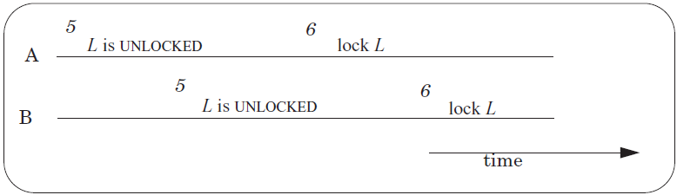
Race Condition Still Exists!
A and B both have the Lock!
Operation-1: Read L to check if its state is LOCKED
Operation-2: Write L to change its state to LOCKED
Not atomic!
Need another lock?
Notes:
How do you handle this in Lab-1?

Slide 30
Primitives to Implement Lock
Hardware atomic instructions
RSM: read-set-memory
Test-and-set, Compare-and-swap
Load-linked + Store-conditional, Fetch-and-add
Pure software solution
Using load and store instructions only
Dekker’s & Peterson’s Algorithms

Slide 31
Test-and-set Instruction
History
Burroughs B5000 in the early 1960’s
1 int TestAndSet(int *old_ptr, int new) {
2 int old = *old_ptr; // fetch old value at old_ptr
3 *old_ptr = new; // store ‘new’ into old_ptr
4 return old; // return the old value
5 }

Slide 32
Spin Lock using Test-and-set
1 typedef struct __lock_t {
2 int flag;
3 } lock_t;
4
5 void init(lock_t *lock) {
6 // 0 indicates that lock is available, 1 that it is held
7 lock->flag = 0;
8 }
9
10 void lock(lock_t *lock) {
11 while (TestAndSet(&lock->flag, 1) == 1)
12 ; // spin-wait (do nothing)
13 }
14
15 void unlock(lock_t *lock) {
16 lock->flag = 0;
17 }

Slide 33
Compare-and-swap
Another hardware primitive
Compare-and-swap (on SPARC)
Compare-and-exchange (on x86)
1 int CompareAndSwap(int *ptr, int expected, int new) {
2 int actual = *ptr;
3 if (actual == expected)
4 *ptr = new;
5 return actual;
6 }

Slide 34
Spin Lock using Compare-and-swap
1 typedef struct __lock_t {
2 int flag;
3 } lock_t;
4
5 void init(lock_t *lock) {
6 // 0 indicates that lock is available, 1 that it is held
7 lock->flag = 0;
8 }
9
10 void lock(lock_t *lock) {
11 while (CompareAndSwap(&lock->flag, 0, 1) == 1)
12 ; // spin-wait (do nothing)
13 }
14
15 void unlock(lock_t *lock) {
16 lock->flag = 0;
17 }

Slide 35
Load-linked and Store-conditional
1 int LoadLinked(int *ptr) { 2 return *ptr; 3 } 4 5 int StoreConditional(int *ptr, int value) { 6 if (no one has updated *ptr since the LoadLinked to this address) { 7 *ptr = value; 8 return 1; // success! 9 } else { 10 return 0; // failed to update 11 } 12 }

Slide 36
Using LL/SC to Build a Lock
1 void lock(lock_t *lock) {
2 while (1) {
3 while (LoadLinked(&lock->flag) == 1)
4 ; // spin until it’s zero
5 if (StoreConditional(&lock->flag, 1) == 1)
6 return; // if set-it-to-1 was a success: all done
7 // otherwise: try it all over again
8 }
9 }
10
11 void unlock(lock_t *lock) {
12 lock->flag = 0;
13 }

Slide 37
Fetch-and-add Instruction
1 int FetchAndAdd(int *ptr) {
2 int old = *ptr;
3 *ptr = old + 1;
4 return old;
5 }

Slide 38
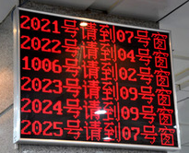
Using Fetch-and-add for Ticket Lock
1 typedef struct __lock_t {
2 int ticket;
3 int turn;
4 } lock_t;
5
6 void lock_init(lock_t *lock) {
7 lock->ticket = 0;
8 lock->turn = 0;
9 }
10
11 void lock(lock_t *lock) {
12 int myturn = FetchAndAdd(&lock->ticket);
13 while (lock->turn != myturn)
14 ; // spin
15 }
16
17 void unlock(lock_t *lock) {
18 lock->turn = lock->turn + 1;
19 }
One difference with previous locks: it ensures progress for all threads

Slide 39
Bootstrapping
Solve the narrow problem using some specialized method
Might work for only that case
It takes advantage of the specific situation
The general solution then consists of two parts:
a method for solving the special case
a method for reducing the general problem to the special case

Slide 40
Bootstrapping (In the case of ACQUIRE)
The solution for the specific problem is
Hardware: building a special hardware instruction that is itself is a before-or-after action
Software: by some extremely careful programming

Slide 41
Assumptions
Bus arbiter
Guarantees that any single LOAD or STORE is a before-or-after action with respect to every other LOAD and STORE
Each entry of the shared array is:
in its own memory cell
the memory provides read/write coherence for memory cells
The instructions execute in program order

Slide 42

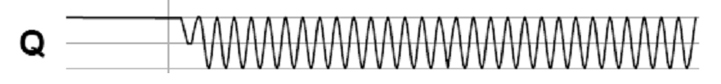
The Bus Arbiter Problem
A:
Arbiter
S:
A:
B:
Clock:
B:
Clock:
S:
t_{E}
Two async inputs (A, B), one sync output
Choose between two asynchronous input
If inputs are closely spaced
Output may be oscillating
Waiting longer only reduce the probability of oscillating

Slide 43
Peterson’s Algorithms
int flag[2]; // assume two threads on two CPUs
int turn;
void init() {
flag[0] = flag[1] = 0; // 1->thread wants to grab lock
turn = 0; // whose turn? (thread 0 or 1?)
}
void lock() {
flag[self] = 1; // self: thread ID of caller
turn = 1 - self; // make it other thread’s turn
while ((flag[1-self] == 1) && (turn == 1 - self))
; // spin-wait
}
void unlock() {
flag[self] = 0; // simply undo your intent
}

Slide 44
Peterson’s Algorithms
Assumptions
Assume loads and stores are atomic with respect to each other, which was true on early hardware
Does not hold on today’s hardware, which has relaxed memory consistency models
So, not used any more
Using a little hardware support is much easier

